Slide 1
MATHEMATICS II
SECOND SEMESTER
02
Differentiation Rules

Slide 2
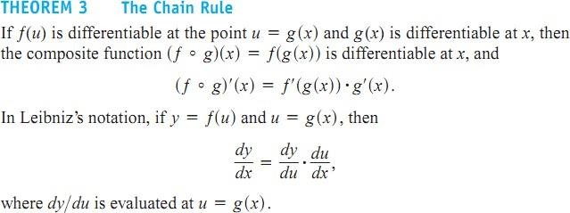
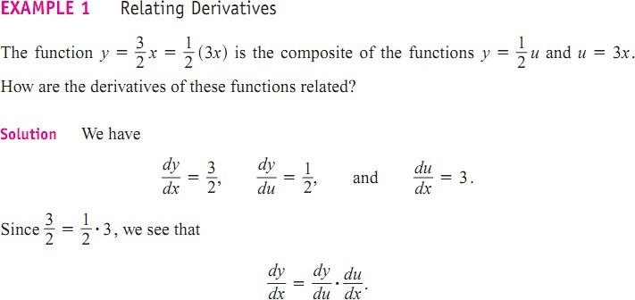
The Chain Rule

Slide 3
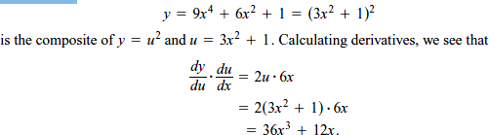
The function •
EXAMPLE 2:

Slide 4
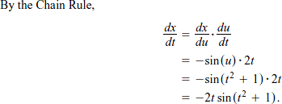

Applying the Chain Rule
EXAMPLE 3:

Slide 5
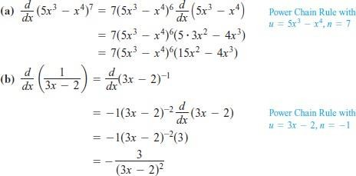
The Chain Rule with Powers of a Function
EXAMPLE :
Applying the Power Chain Rule

Slide 6
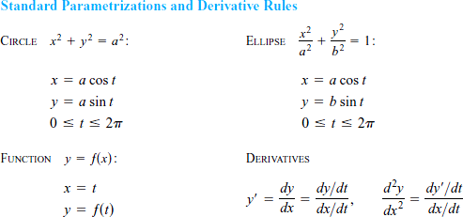

Parametric Equations
EXAMPLE 5: Moving Counterclockwise on a Circle, Graph the parametric curves.

Slide 7
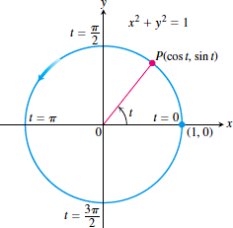
Solution:

Slide 8
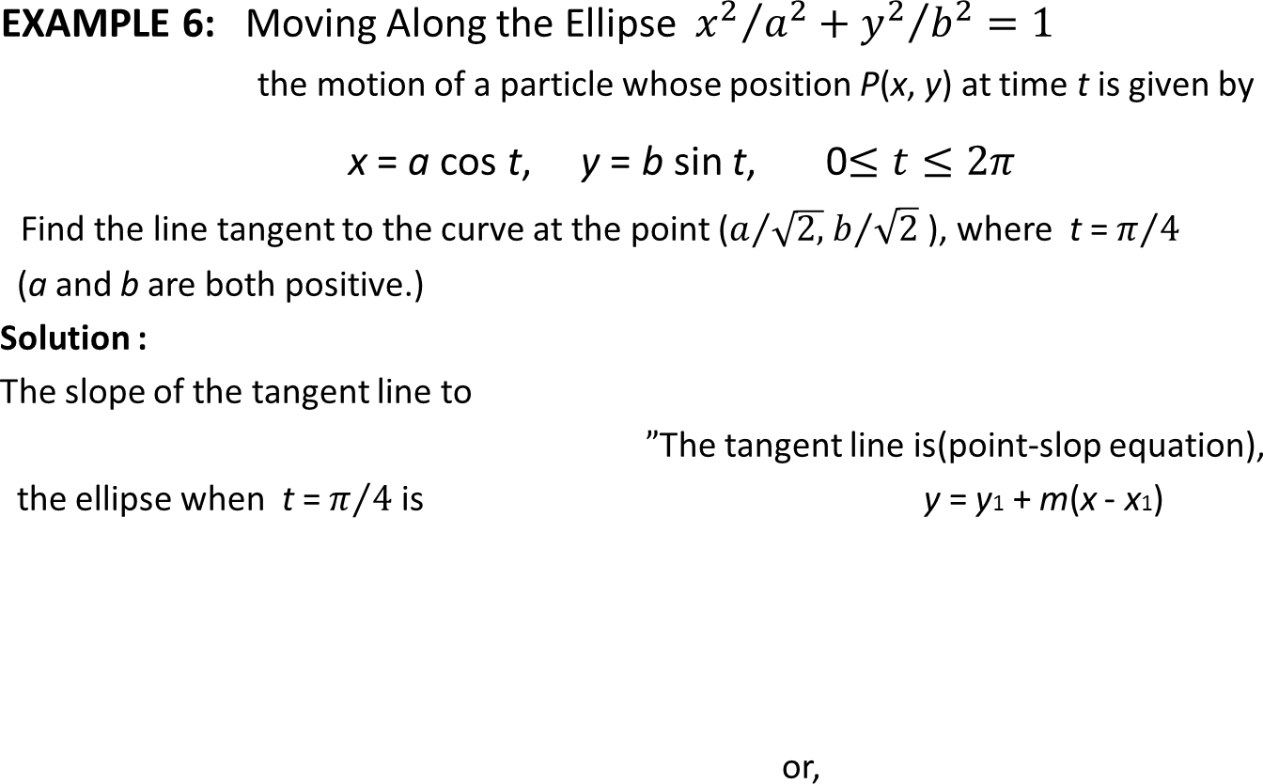
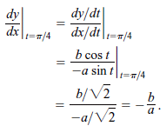


Slide 9
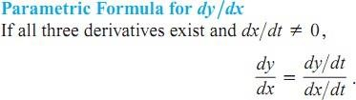
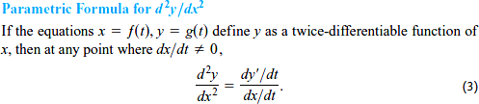
EXAMPLE :
EXAMPLE 7 :

Slide 10
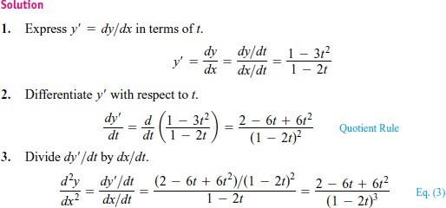

Slide 11
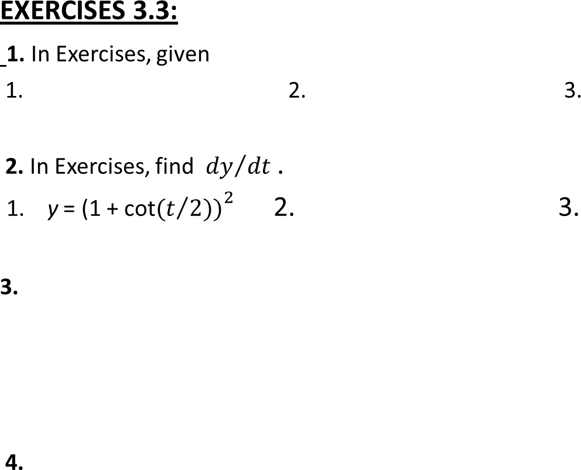




Slide 12
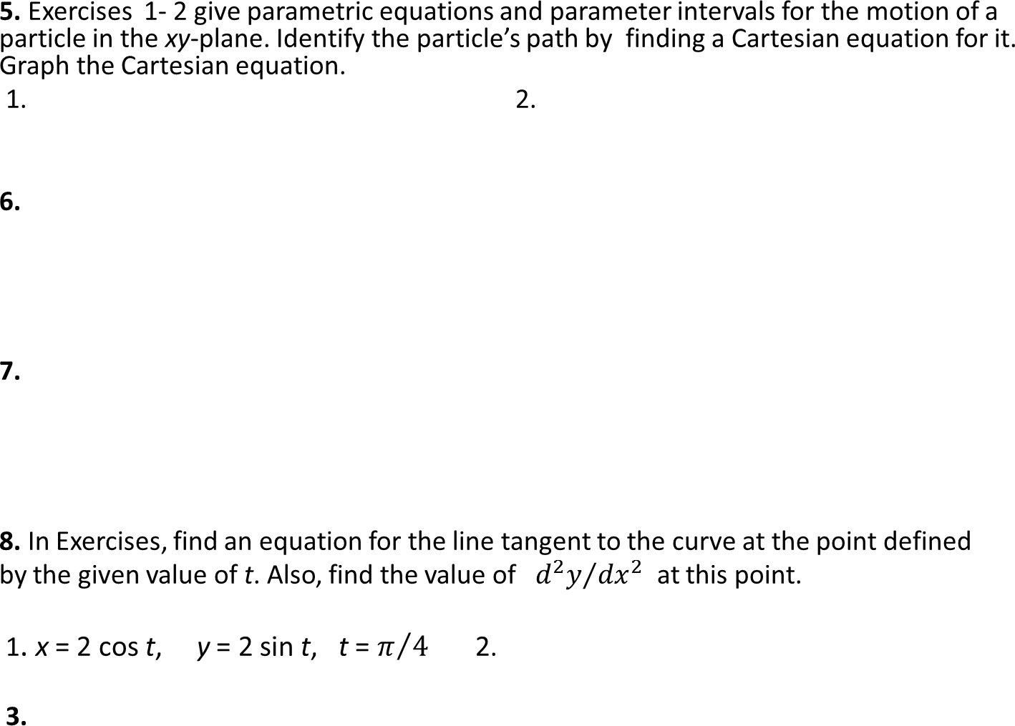

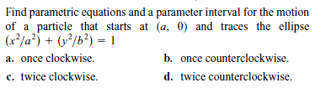

Slide 13
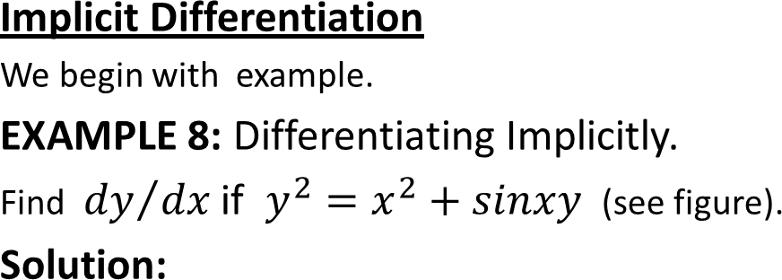
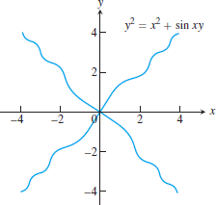
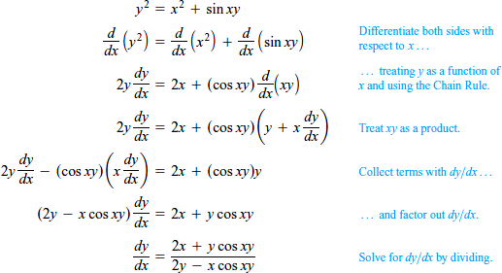

Slide 14
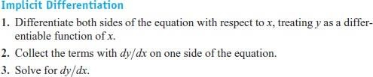
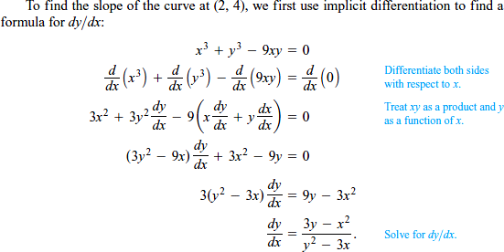

Slide 15
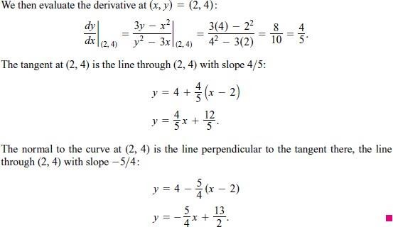
E
XAMPLE : Finding a Second Derivative Implicitly
EXAMPLE 10: Finding a Second Derivative Implicitly

Slide 16
